Slide 1
Lao Business Forum Financial Sector Working Group Workshop meeting Sectoral issues for the 2019 Lao Business Forum
LNCCI, 15 May 2019

Slide 2
Welcome and workhop agenda
Workshop objective: obtain working group members feedback on sectoral issues and agree on next steps
Agenda | Presented by | Time
Opening remarks | Ms. Valy Vetsaphong, Vice President of LNCCI | 8:30-8:45
Update on working group issues | LBF Secretariat | 9:00-9:15
Presentation key issue 1 | Rob Kaanen, Project Consultant | 9:15-9:45
Roundtable discussion | All participants | 9:45-10:15
Break |  | 10:15-10:30
Presentation key issue 2 | Rob Kaanen, Project Consultant | 10:30-11:00
Roundtable discussion | All participants | 11:00-11:40
Wrap-up and closing remarks | Ms. Valy Vetsaphong, Vice President of LNCCI | 11:40-12:00

Slide 3
Introduction
The Lao Business Forum (LBF) is a platform for public private sector dialogue, aimed at
Ensuring consistent enforcement and interpretation of laws
Removing impediments to business
Providing feedback on Government laws and regulations
The LBF receives technical support from the Lao Competitiveness and Trade (LCT) project and its secretariat is maintained by the LNCCI
The LBF is organized at four levels
Private sector working groups where policy ideas are discussed and formulated
Public private sector consultation meetings
A Steering Committee to review progress and agree on key forum inputs
An annual forum meeting to inform about achievements and unresolved issues
The next LBF will take place in October 2019

Slide 4
Update on financial sector working group issues (1)
Issues raised at the previous working group meeting on …….
Foreign currency lending and FX conversion
Credit information sharing
Reserve requirements
Leasing in LAK
Deductibility of VAT
Double taxation of reinsurance
National payment system
+ Lack of benchmark interest rates for longer maturities
Issues were further investigated during interview round April – May
Interest rate caps issue considered resolved as repealed through Agreement 140/BoL of 12 February 2019

Slide 5
Update on financial sector working group issues (2)
Based on …………..
Policy notes prepared on two key issues
Credit information sharing
Registration of credit documentation and loan security agreements
Next steps for working group in lead up to business forum:
Aaaa
Bbbb
Cccc

Slide 6
Key issues presentation and discussion
Credit information sharing
Registration of credit documentation and loan security agreements

Slide 7
Information sharing has a positive impact on credit conditions and a credit registry has been operating in Lao since 2012
Public and private credit registries exist to improve the information available on borrowing firms and individuals
Credit information sharing can allow lenders to extend greater credit at more favourable interest rates
The Credit Information Center (CIC) was established in 2012 under the Bank of Lao and financial sector membership is compulsory
The CIC scores quite well in the World Bank’s annual Doing Business Report on depth of information coverage
CIC includes both firms and individuals
Positive and negative credit data covered
Online access
Contains more than two years of historical data
However, at 14.5% of the population, the coverage of firms and individuals is below the East Asia & Pacific region average

Slide 8
As a public credit registry, the CIC has been improving its services, but Lao does not have a fully fledged credit bureau
Studies have shown that credit bureaus have a greater impact on improving the credit environment than a public credit registry, especially for smaller firms*
Credit bureaus can lower lenders operational cost and improve profitability
A credit bureau would offer value added services, such as
Credit scoring
Reporting services
Broader range of information, including data from retailers, utility companies and increasingly alternative data from mobile phone and social media
Over the years, the CIC has been expanding its membership by including more leasing companies, MFIs and offering more flexible pricing plans
Further improvement plans in the pipeline
Include utility provider data and links to Government databases
CIC will become a separate legal entity over the next 6 months
Plans for the selection and procurement of a new IT platform
* = IFC presentation on global credit reporting program (2015). Credit Reporting and Financing Constraints. World Bank Policy Research Working Paper (2003)

Slide 9
The sector raised concerns before about the the information coverage and quality of customer credit information provided by the CIC
The issue was raised before at the 2017 Lao Business Forum
In a survey conducted last year by the CIC
Almost half responded that the information provided by CIC is insufficient
Two-third said that the CIC information does not meet business requirements
Information coverage is seen as too limited
Retail and utility provider data not included
CIC not linked to other Government databases
Data quality issues, caused by
Monthly refresh and manual data upload, prone to errors and delays
Limited data validation performed by CIC and cross-referencing other databases
Limited enforcement of the membership rules on obligation to provide accurate data
* = CIC membership survey where a total of 16 financial institutions provided survey responses

Slide 10
The CIC’s service offering is seen as too limited to respond to the needs of the industry
Limited search capability and reporting
Database search through manual query, but no system to system interface
Automated set of standard reports does not exist
Lack of value added services, such as
Credit scoring and credit trend reports
Bespoke reporting of sectoral data
Historical evolution of credit grades (A/B/C)

Slide 11
For discussion: Improvements to be requested from the public sector
Implementation planning of CIC upgrades for improved information coverage and data referencing
Better enforcement of accurate reporting standards by the Bank of Laos supervision departments
Regular membership dialogue to update the membership on new developments through newsletters and communication sessions
The sector should be consulted on the business requirements for the new IT platform
Involvement of the user community in business requirements gathering through process-, documentation- and data analysis, workshops, focus groups and membership surveys
User community representatives included in project governance over business requirements validation, approval and sign-off
Participation in the vendor selection workshops, prototyping, pilots and user acceptance testing
Consultation on data migration planning and system conversion

Slide 12
Key issues presentation and discussion
Credit information sharing
Registration of credit documentation and loan security agreements

Slide 13
Secured lending is very common and formal registration requirements are imposed by the Law and the Bank of Laos
Land titles are the most readily available collateral
Official land titles (“golden border”) are registered the Land Management Division of the Ministry of Natural Resources and Environment
Urban areas 70-80% covered, but in rural areas only 20-30%
But sporadic land title registration not affordable for the rural population
Bank of Laos placed restriction on use of Village Head certified land titles (“white border”) in November 2017
Loan and security interest agreements need to be notarized* for these to be accepted by the People’s Court in case of disputes
Security interest agreement needs to be registered** in order to have preferential rights of priority. For immoveable assets with
The Division of Land Management of the Ministry of National Resources and Environment, AND
State Asset Management Department under the Ministry of Finance
* Under Lao Contract Law and the Law on Notary Offices
** Law on Secured Transactions (2005) and the related Decree (2011), and the Decree on Document Registration No. 52/PM of 1993

Slide 14
The registration process of the loan agreement and security interest is cumbersome and the fees are considered high
The registration process involves 6 different steps with 4 different Government bodies
The total time to complete the entire process: between 2 and 4 weeks
(Not counting any time spent on agreements between the bank and the customer)
Total number of Government office visits involved: between 7 and 11
(Some office visits involve regional travel and/or waiting time at the office)
Total third-party fees* payable: range of LAK 2 to 4 million
(Excluding out-of-pocket expenses, own time, travel costs and bank fees)
* The security agreement registration fee charged by the Land Management Office has been subject to discussion at the 10th Lao Business Forum in 2017, where it was proposed to cap these fees at a maximum level of LAK 1,000,000 per loan item. A proposal along these lines has been submitted by the Ministry of Justice to the National Assembly for consideration and promulgation through Presidential Decree.

Slide 15
Formal requirements present an unnecessary high burden on the lending process restricting access to finance
Lack of substance or added value of certain steps
Notary Office stamping, when checks and verifications of agreement correctness, encumbrances or Court proceedings are not performed, while authentication has already been performed by the Village Head
Registration (perfection) of security interest over immoveable asset at both the Land Management Office and the Department of State Asset Management
Lack of transparency of fees
Difficult to know in advance what level of fees are involved, as payment of “express fees” may be required
Regional variations in fees
Online consultation of land register and Court judgments not possible
Limitations placed on access to finance by only using officially registered land titles

Slide 16
For discussion: Improvements to be requested from the public sector
Process simplification
Online service for request for authentication of land title, encumbrances and pending Government land projects
Notarization of loan and security agreements should be eliminated and/or performed online
Registration of the security interest in immoveable assets at the Department of State Asset Management should be eliminated
Standard and published fee scales
Fixed amount/capped fees for sets of documents, not based on number of pages or loan amount
Where possible, fee payments should be made via bank transfer or accepted at via a Point-of-Sales (POS) terminal only
Permission to use Village Head certified land titles for “soft collateral” lending in areas with low rates of formal land titling under certain circumstances (< amounts, pledging of security interest, authentication by the Village Head and reporting to the CIC)

Slide 17
Outline of proposal to the public sector
Requested next step | Addressed to
Create online forms and online process to perform query of land title database Online notarization of loan and security agreements Introduce online and digital payment of fees instead of cash | eGovernment Department of the Ministry of Post and Telecom and the Land Management Division of the Ministry of Natural Resources and Environment
Reconsider the notarization requirement of loan and security agreements Adapt the fee schedule for notarization of loan and security agreements Create a central database of Court judgments | Ministry of Justice
Unify the fee scales across the country for Village Head authentication of loan and security agreements | Ministry of Home Affairs
Reconsider the requirement to register loan and security agreements over immoveable assets at the Department of State Asset Management | Ministry of Finance
Issue clarification in relation to Notice 818/BoL, that pledging of Village Head authenticated land titles is allowed under specific circumstances | Bank of Laos

Slide 18
Wrap-up and next steps
Summary of workshop conclusions
Agreed next steps

Slide 19
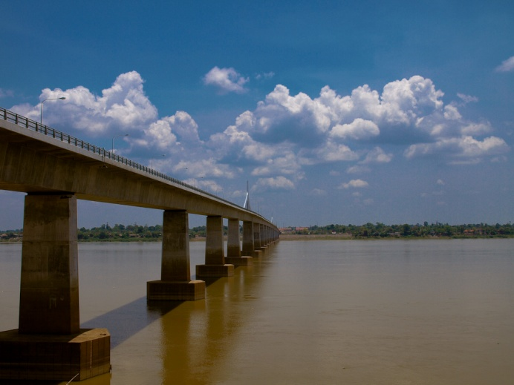
Thank You

