Slide 1
What is key to Lao PDR’s Economic Takeoff ?
March 27th, 2023
14th Lao PDR Business Forum

Slide 2
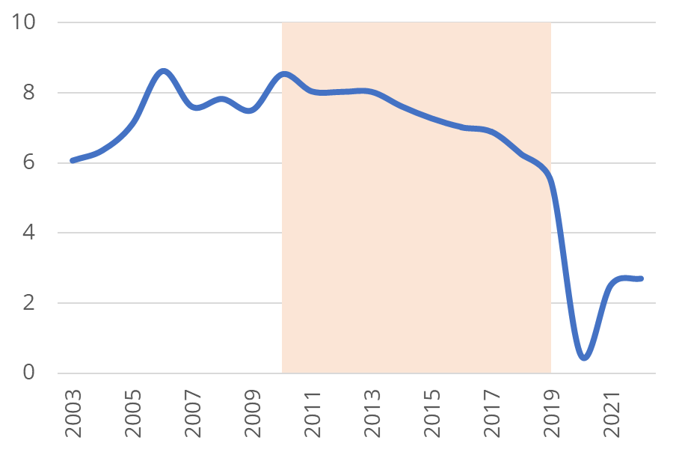
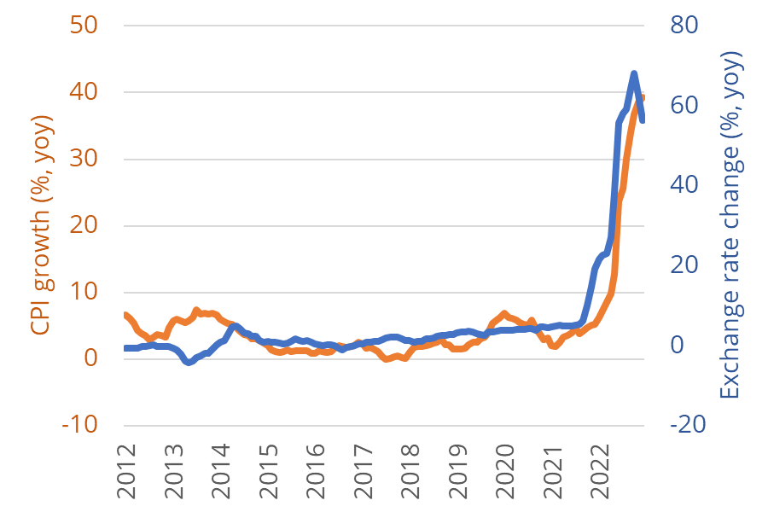
Some context for this talk
GDP growth decelerated before Covid-19
reflecting an unsustainable economic model
The macroeconomic environment has deteriorated considerably in 2022

Slide 3
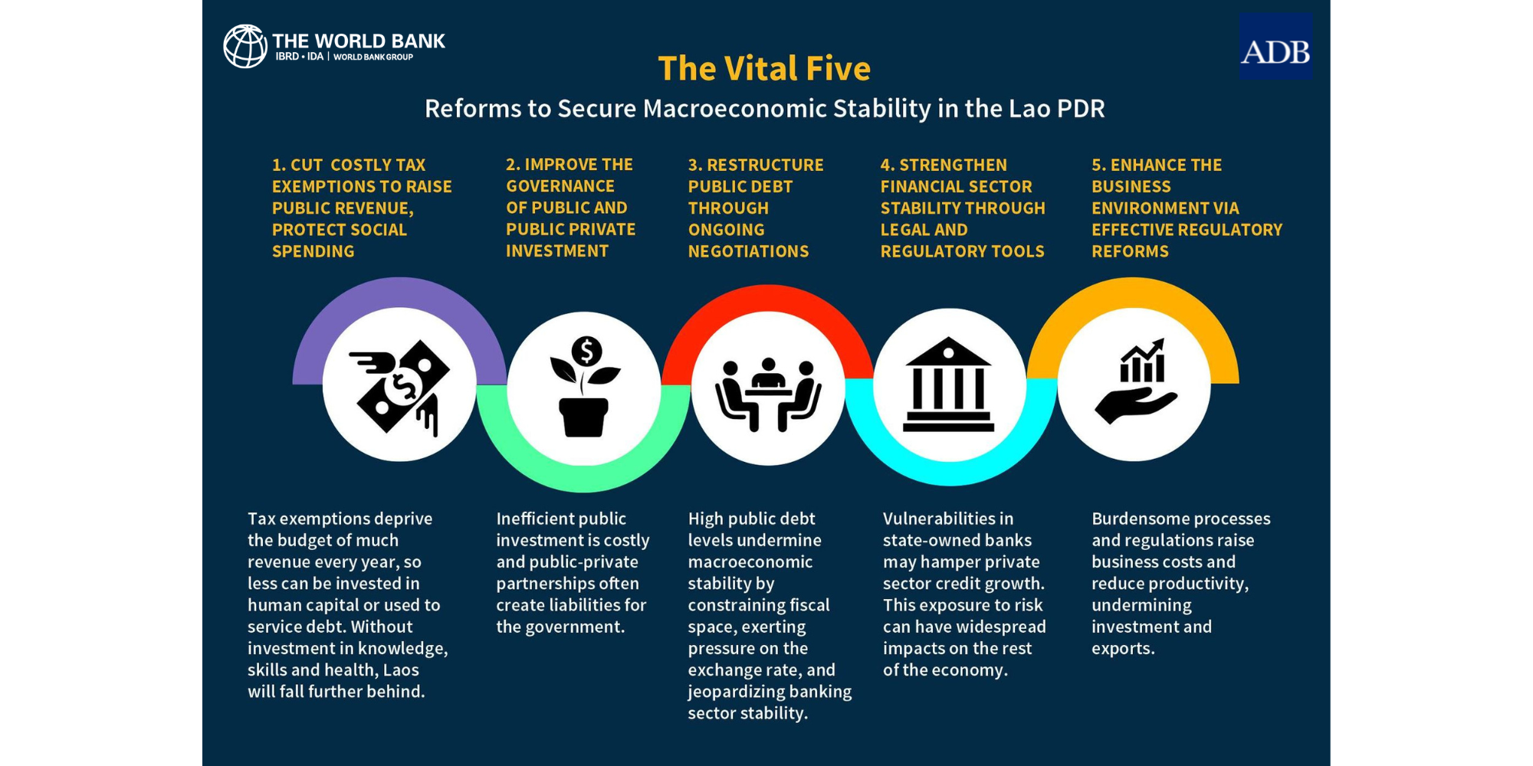

Slide 4
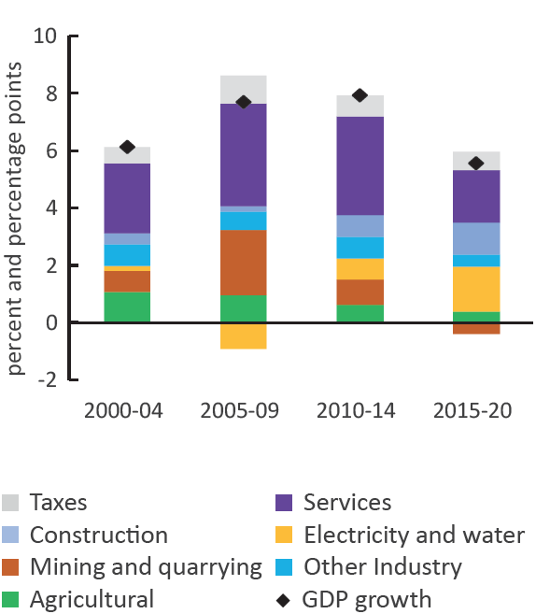
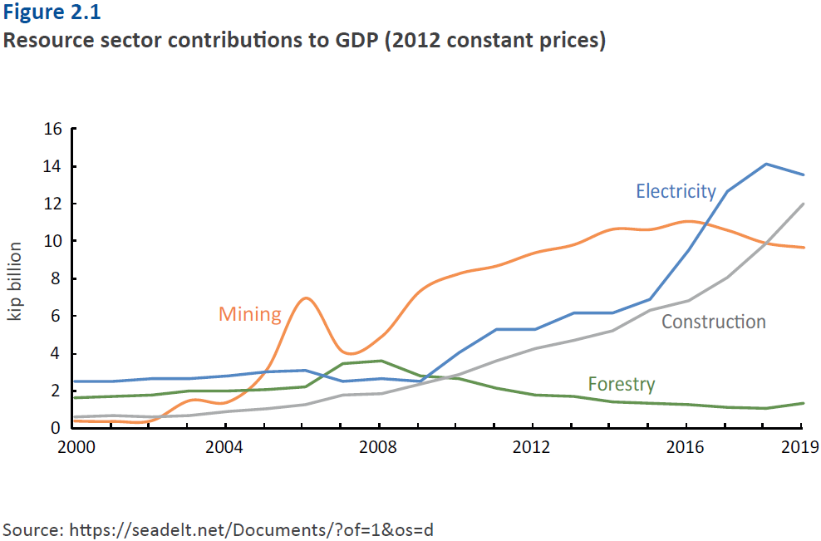
Natural resources drove fast growth …
GDP growth and sectoral contribution to growth
Resource sector contributions to GDP
(2012 constant prices)
Source: World Bank Country Economic Memorandum (2022)

Slide 5
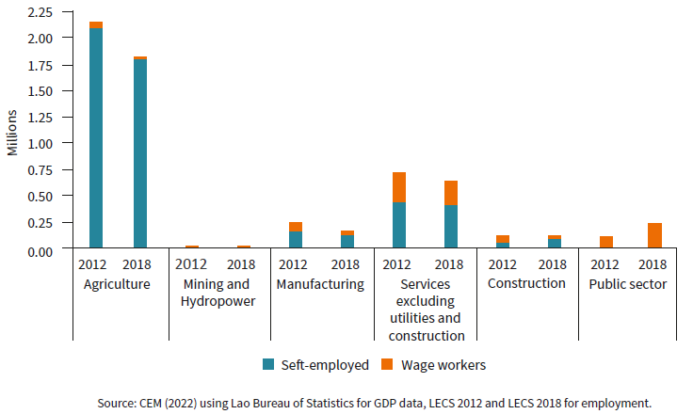
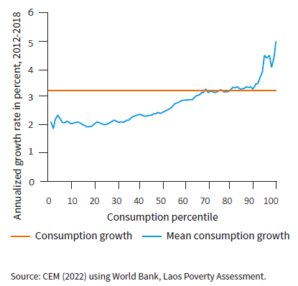
… but this growth was not job-creating nor inclusive
All sectors, except the public and a few manufacturing and services subsectors, experienced a net decline in employment, 2012-18
Consumption growth has been
shewed towards rich households

Slide 6
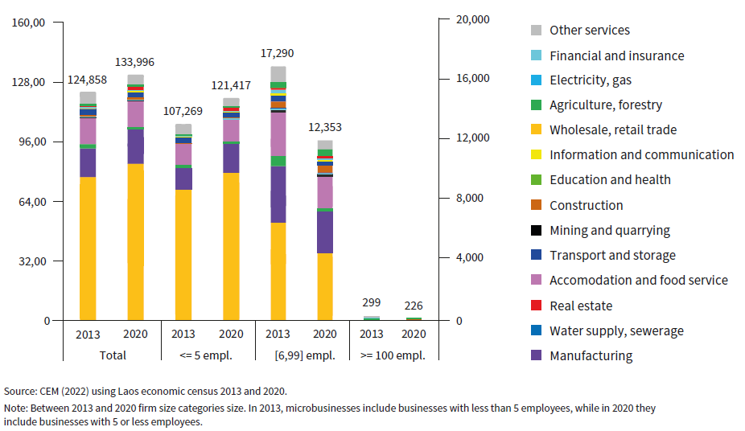
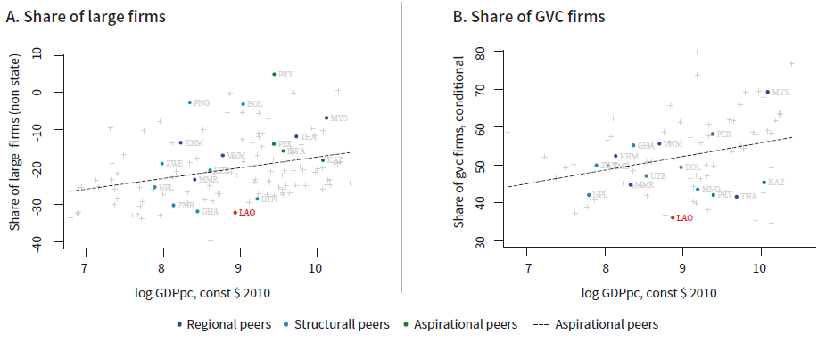
Formal private sector is small and lacks large, internationally oriented firms

Slide 7
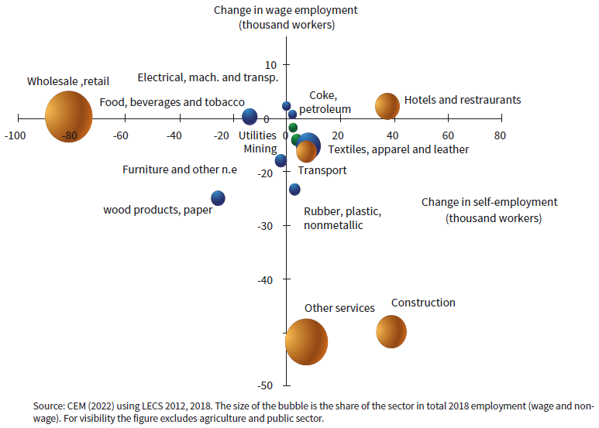
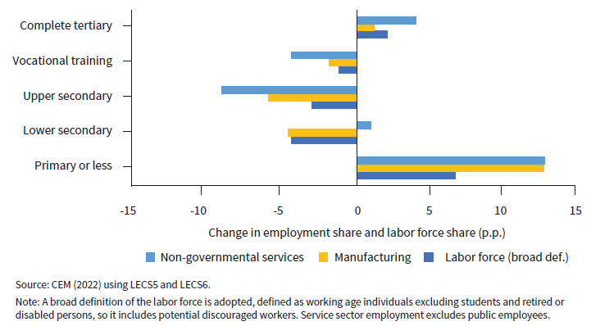
Employment shifted largely towards low-skilled and self-employed workers
Change in skills composition of employment and labor force, 2012 - 2018
Businesses also replaced wage workers with self-employed workers
Wage and non-wage labor dynamics by sector, 2012-2018

Slide 8
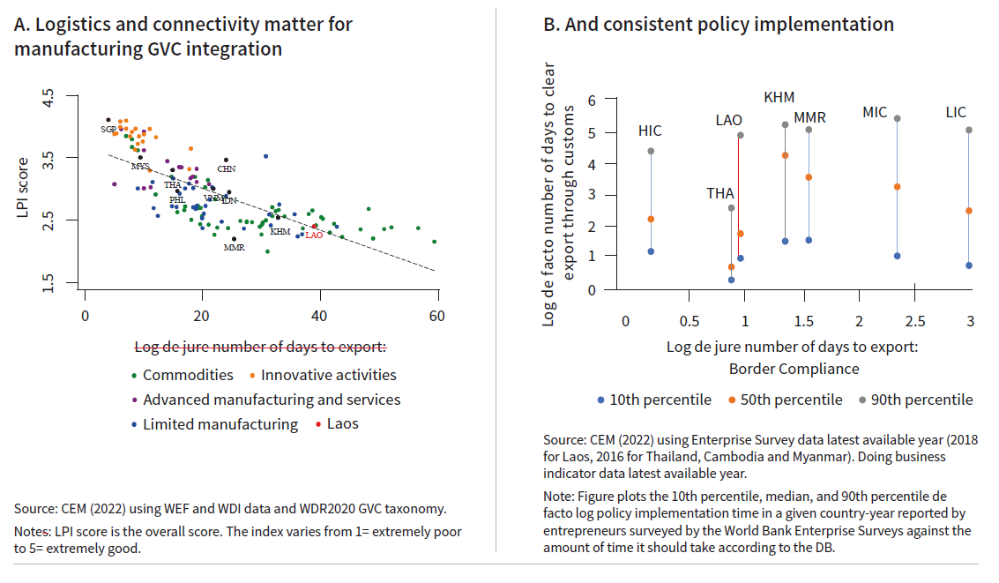
Scope to improve manufacturing competitiveness
Global value chains thrive on predictable business environment

Slide 9
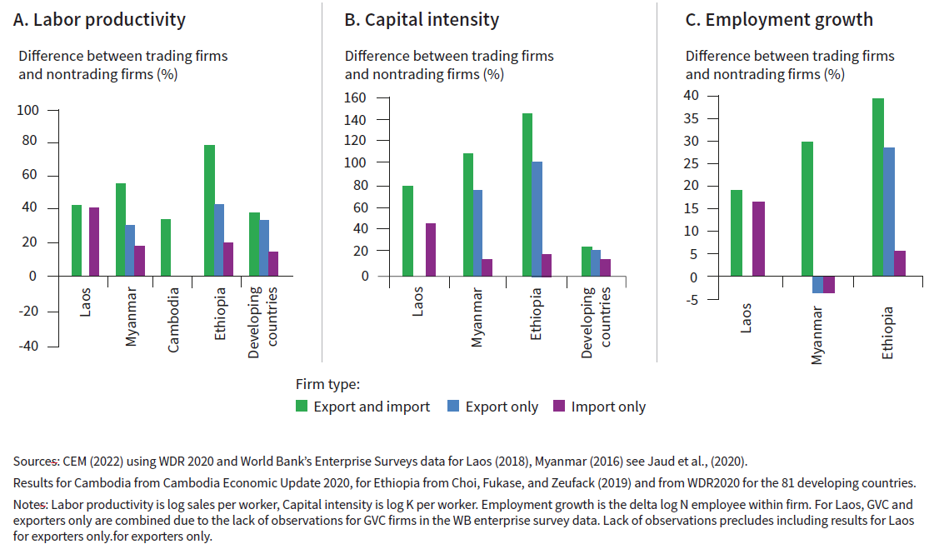
Scope to improve manufacturing competitiveness
GVCs firms are more productive, capital intensive and employ more workers

Slide 10
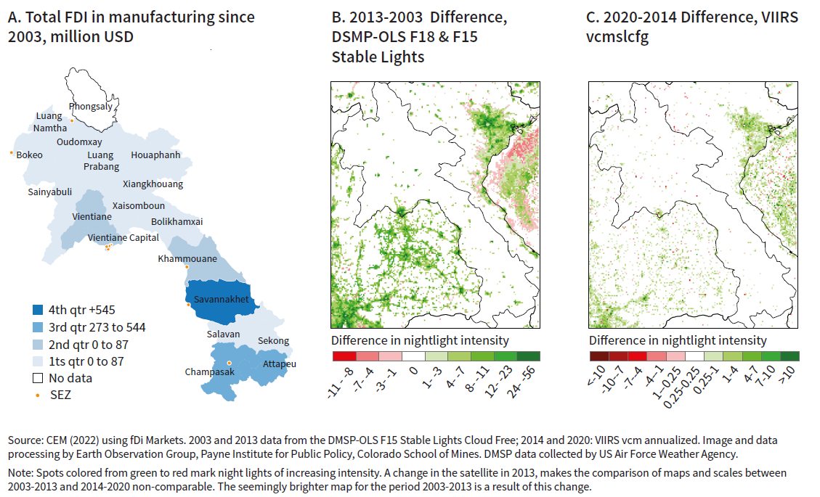
Scope to improve manufacturing competitiveness
Export-oriented manufacturing FDI linked to local economic development

Slide 11
Policies priorities to support Lao PDR’s economic takeoff

Slide 12
Boost and connect exports
Remove trade barriers and invest in infrastructure to increase the scale of exports
1. | Continue to simplify the tariff structure.
2. | Implement fully paperless trade systems
3. | Enhance border management by targeting border controls on high-risk trade
4. | Streamline non-tariff measures to support exports
5. | Improve domestic and regional connectivity to augment market size and to facilitate labor mobility

Slide 13
Diversify into labor-Intensive exports
Remove policy-induced distortions that limit the efficient allocation of labor, capital, and land to enable more productive firms both domestic and foreign to grow and create formal jobs.
1. | Improve business registration processes and the operating licensing regime
2. | Simplify and reduce entry conditions to attract foreign investment
3. | Revise the Law on Investment Promotion to curb tax incentives and exemptions.
4. | Facilitate links between SEZs and the domestic economy

Slide 14
Raise skills of the labor force
Invest in skills and ensure a well-functioning labor market to prepare the workforce to handle the complexities of globalized production systems and in turn contribute to more inclusive growth
1. | Invest in human capital to stimulate economic diversification
2. | Promoting skill retraining and geographically targeted-employment incentives.
3. | Strengthening labor laws and their enforcement

Slide 15
Make or break opportunity for Lao PDR business forum
LBF excellent visibility with LNCCI strong leadership to link LBF and business environment reforms
But some way to go to ensure sustainability
LNCCI needs to show sustained progress under LBF 13th (as of Nov 2022 - 2 of the 49 issues raised were resolved)
Lao Competitiveness and Trade Project ends Dec 2024
=> 2 years left to make itself indispensable to the private sector

Slide 16
Make or break opportunity for Lao PDR business forum
Boost the issues resolution rate:
Short results framework style matrix to government including:
the responsible agency or ministry
top 3 issues that need resolution under this agency
Indication of the benefits for the government and the nation of resolving the issue
indicator of resolution specified
timeline for resolution
Responsible agency or ministry to report back to the PMO on progress [cc. LBF Secretariat], within 3 months after LBF14
Aim for a 90% resolution rate within 12 months?

Slide 17
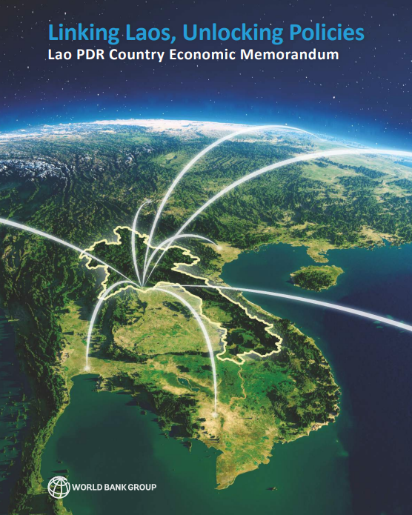
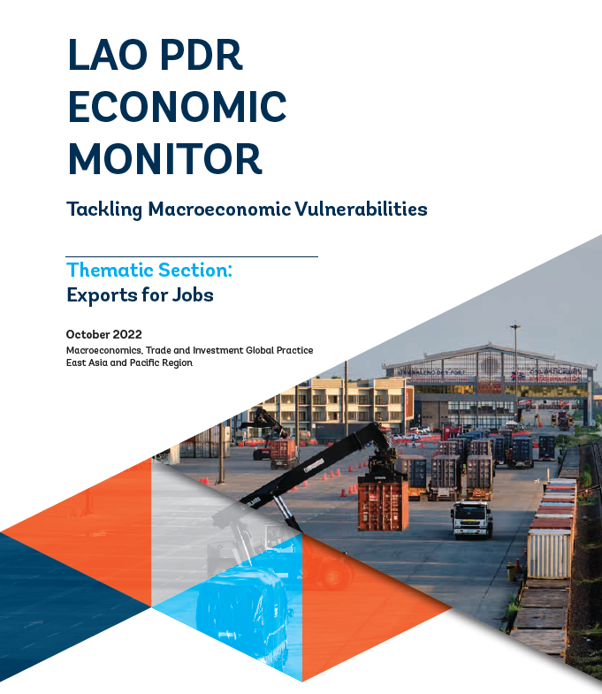
Country Economic Memorandum (2022) “Linking Laos Unlocking Policies”
http://wrld.bg/tmsw50JmKGa
Lao PDR Economic Monitor (Oct 2022) Tackling Macroeconomic Vulnerabilities

